Slide 1
Multithreading
POSIX Thread IEEE 1003.1c

Slide 2
Contents
Multitasking vs Multithreading
Process
Threads
Why Threading
POSIX Threads
POSIX Thread APIs
Creating and Terminating Threads
Joining and Detaching Threads
Mutual Exclusion

Slide 3
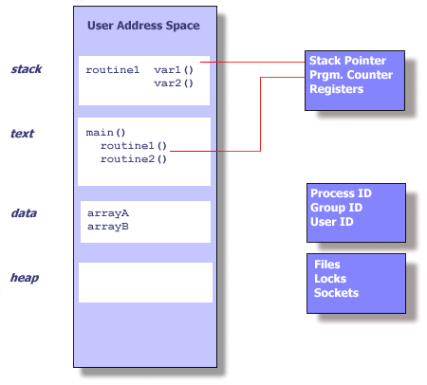
Process

Slide 4
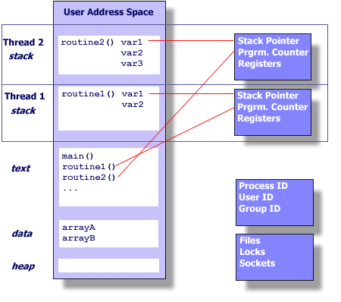
Thread

Slide 5
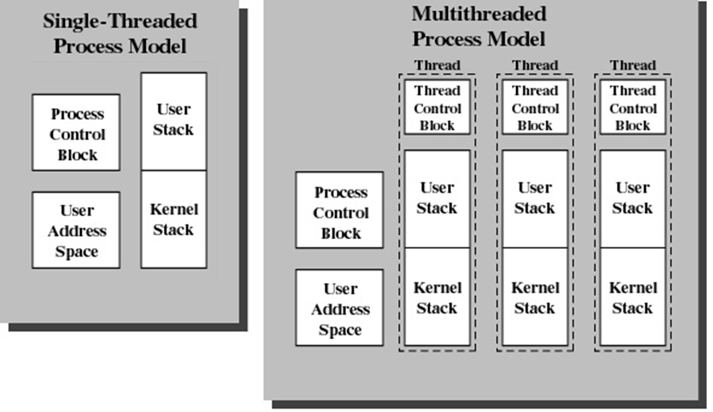
Multitasking vs Multithreading

Slide 6
Why Threading
Multitasking/Multiprogramming
fork() in Linux/Unix
Problems
Time to create new process
Memory requirements
Switching Time for scheduling
Solution
Multithreading
pthread_create() in Linux/Unix

Slide 7
Creating a new Process
pid = fork()
if ( pid < 0 )
{ printf ("fork failed,Error = %d\n", pid); exit(0); }
else if (pid ==0) /* this is the child of the fork */
{ do_nothing(); exit(0); }
else /* this is the parent of the fork */
{ waitpid(pid, status, 0); }

Slide 8
Creation Time
50,000 processes or threads creation time in seconds
Platform | fork() | pthread_create()
Intel 2.6 GHz Xeon E5-2670 (16cpus/node) | 8.1 | 0.9
Intel 2.8 GHz Xeon 5660 (12cpus/node) | 4.4 | 0.7
AMD 2.3 GHz Opteron (16cpus/node) | 12.5 | 1.2
AMD 2.4 GHz Opteron (8cpus/node) | 17.6 | 1.4
IBM 4.0 GHz POWER6 (8cpus/node) | 9.5 | 1.6
IBM 1.9 GHz POWER5 p5-575 (8cpus/node) | 64.2 | 1.7
IBM 1.5 GHz POWER4 (8cpus/node) | 104.5 | 2.1
INTEL 2.4 GHz Xeon (2 cpus/node) | 54.9 | 1.6
INTEL 1.4 GHz Itanium2 (4 cpus/node) | 54.5 | 2

Slide 9
Benefits of Threads
Less time to
create a new thread than a process
terminate a thread than a process
switch between two threads within the same process
Low Memory Requirements than Multiprogramming
Since threads within the same process share memory and files, they can communicate with each other without invoking the kernel

Slide 10
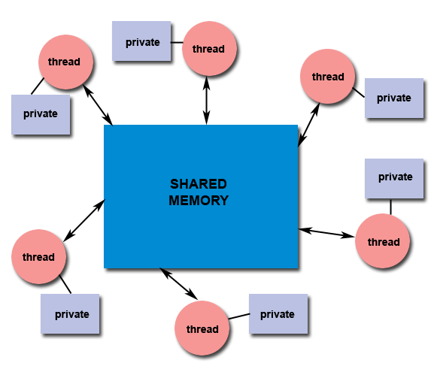
Shared Memory
All threads have access to the same global, shared memory
Threads also have their own private data
Programmers are responsible for synchronizing access (protecting) globally shared data.

Slide 11
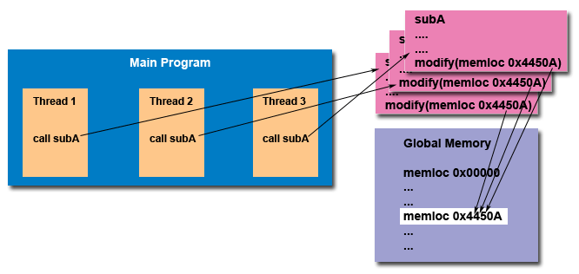
“Thread Safe”

